Slide 1

Fraud Detection
Arthi Komma
Campus id – GF89659

Slide 2
Agenda
Introduction
Characteristics of the dataset
Visualizations
Summary
References

Slide 3
Introduction
Fraud detection is a critical problem in many industries, including finance, insurance, and e-commerce. Machine learning algorithms can be used to detect fraudulent activities by analyzing large datasets of transactions and identifying patterns and anomalies that indicate fraudulent behavior. It requires careful data collection, preprocessing, feature engineering, model selection, training, evaluation, deployment, and monitoring to achieve accurate and effective fraud detection.

Slide 4
Characteristics
The dataset is a synthetic dataset that simulates a mobile money transaction network. It consists of approximately 6 million rows and 11 columns, representing transaction record.
Dataset Reference - https://www.kaggle.com/datasets/ealaxi/paysim1

Slide 5
Features
The features in the dataset include:
step - The timestamp of the transaction in hours.
type - The type of the transaction (e.g., CASH_IN, CASH_OUT, PAYMENT, TRANSFER, or DEBIT).
amount - The amount of the transaction.
nameOrig - The customer initiating the transaction.
oldbalanceOrg - The initial balance of the customer initiating the transaction.
newbalanceOrig - The new balance of the customer initiating the transaction after the transaction is complete.
nameDest - The recipient of the transaction.
oldbalanceDest - The initial balance of the recipient before the transaction.
newbalanceDest - The new balance of the recipient after the transaction.
is Fraud - A binary indicator of whether the transaction is fraudulent.
isFlaggedFraud - A binary indicator of whether the transaction is flagged as fraudulent by the simulation.

Slide 6
Cleaning/Pre-processing
The dataset requires some pre-processing and cleaning before being used for analysis. This includes:
Removing duplicate rows and checking for missing values.
Removing irrelevant columns that are not useful for analysis.
Addressing class imbalance, as the dataset has many non-fraudulent transactions compared to fraudulent transactions.
Normalizing the numerical variables to a common scale, as they have different ranges.

Slide 7
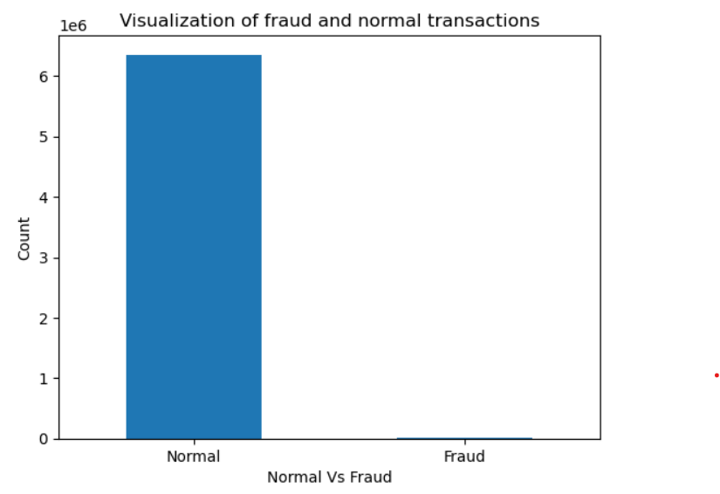
Visualizations
1. The chart illustrates the fraudulent and non-fraudulent transactions in the dataset.

Slide 8
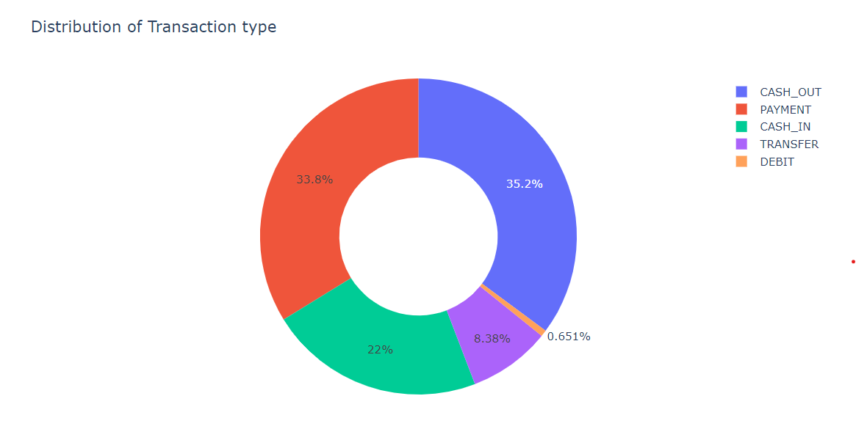
The chart illustrates the percentage of transaction types present in the dataset.

Slide 9
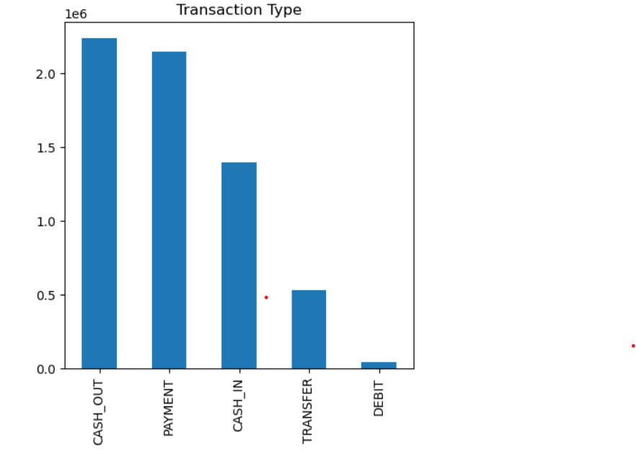
The chart illustrates the total count of types of transactions present in the dataset.

Slide 10
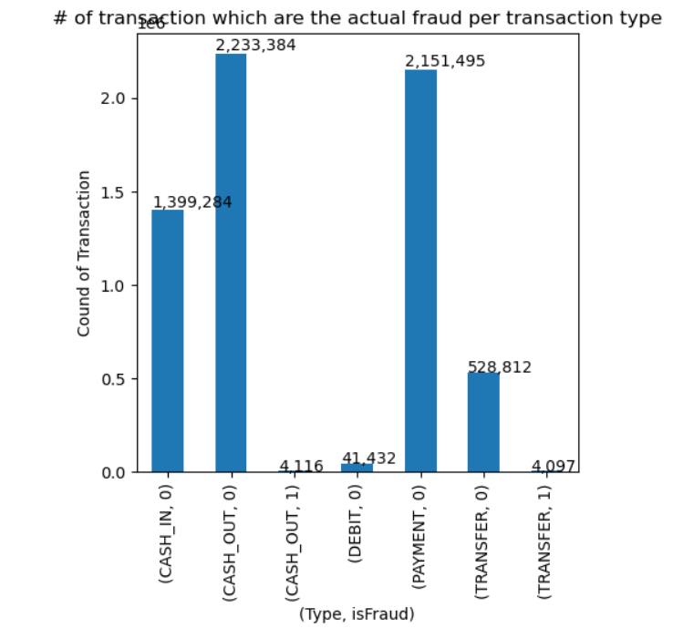
The chart illustrates that fraudulent transactions can be Cash-out and Transfer.

Slide 11
Summary
I analyzed the financial transactions data and developed a machine learning model to detect fraud. The analysis included data cleaning, exploratory analysis and predictive modeling.
In the data cleaning, I checked for missing values, columns names and summarized the variables in the data.
In the EDA process, I have found that the transactions which are fraud are mostly 'Cash-Out' and 'Transfer'.
In the predictive modelling process, I have found the imbalance in the dataset and used under-sampling method to balance the dataset.
Later I performed classification models on the dataset and the accuracy, F1, recall and precision scores of the models. It is found that the Decision tree classification model has the highest accuracy of 0.99 when compared to other models.
This is the end of my mid-term project and for my final project I’ll be choosing different topic.

Slide 12
References
https://www.projectpro.io/article/credit-card-fraud-detection-project-with-source-code-in-
https://towardsdatascience.com/credit-card-fraud-detection-using-machine-learning-python-5b098d4a8edc
https://data-flair.training/blogs/credit-card-fraud-detection-python-machine-learning/

Slide 13
Thank you

